Slide 1














Deployment
Version 6.x
© ThoughtSpot Inc 2019
Notes:
Steps for deployment:
Set up cloud instance (AWS, azure, gap)
Download binary (tarball) from secure site
Scp binary to cluster
Check the binary integrity using checksum
Run the cluster create command through tscli

Slide 2
Learning Objectives
Learn how to deploy ThoughtSpot cluster
Notes:
Skills: Linux
Requirements: Terminal or putty equivalanet, browser (Chrome)

Slide 3










Next Generation Analytics Platform
RELATIONAL
SEARCH
PINBOARDS
EMBEDDED & APIS
AUTOMATED INSIGHTS
MOBILE
BUSINESS MONITORING
INSIGHTS
FEED
SEARCH ENGINE
SPOTIQ AI ENGINE
PERSONALIZATION ENGINE
DISTRIBUTED CLUSTER MANAGER
ENTERPRISE SECURITY &
GOVERNANCE
BI & VISUALIZATION SERVER
IN-MEMORY CACHE
EMBRACE
DATA LOAD
LIVE QUERY
On-prem EDW & DB
Data Lake
Apps (Salesforce, Marketo, etc.)
CSVs

Slide 4
Platform

Slide 5


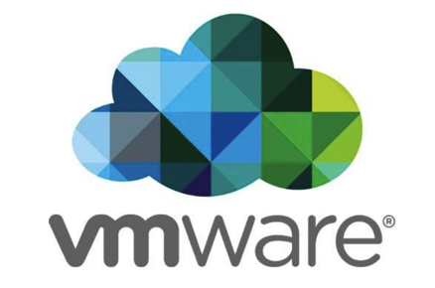
Deployment Options
Software
TS Cloud
Notes:
Appliance: Each appliance takes up to 1 TB of data and you can stack them up like lego blocks to scale, which makes it great for departmental or enterprise-wide deployments.
Our second deployment option is a Private Cloud offering where we will provide you with software certified to run on VMWare. For large enterprises, that want more control and have the technical infrastructure expertise in-house this can be an attractive option.
We have a public cloud offering available to run on your instance of AWS, gcp, azure.
Once a sale is complete, the Egnyte link is automatically sent to customers.

Slide 6
Cloud Platform Type
 | AWS | Azure | GCP
Instance Type | r4.16xlarge | E64 v3 | n1-highmem-64
CPU | 64 | 64 | 64
Memory | ~512GB | ~400GB | ~400GB
Disks | 1 X 200 GB 2 X 2 TB | 1 X 200 GB 2 X 2 TB | 1 X 200 GB 2 X 2 TB
Notes:
AWS: r4.16xlarge : 64 CPU, 488 GB RAM per node
Azure: E64 v3 : 64 CPU, 432 GB RAM per node
GCP: n1-highmem-64 : 64 CPU, 416 GB RAM per node
Types of instances that is necessary to support TS (minimum).

Slide 7
ThoughtSpot Deployment (on CentOS)

Slide 8
ThoughtSpot Deployment (on CentOS)
Steps for deployment:
Set up cloud instance by installing ThoughtSpot image (i.e. CentOS machine with customizations)
Download binary (tarball) from secure site
Scp binary to cluster
Check the binary integrity using checksum
Run tscli cluster create
Falcon
Sage
Blink
Tomcat
Orion
TS CentOS
Notes:
We first provision a CentOS 7 machine. Then, we make a lot of TS customizations, which refers to tscli (to create cluster), but that CentOS machine that you first provision doesn’t’ have tscli. So that is one of the binaries you need before the cluster is running. Also, creating the admin users, etc- TS customizations on the machine.
Then, the create an image out of it and push it to the Marketplace so that customers could provision machines using TS publically facing images.
Benefit! We control everything on the OS layer.

Slide 9
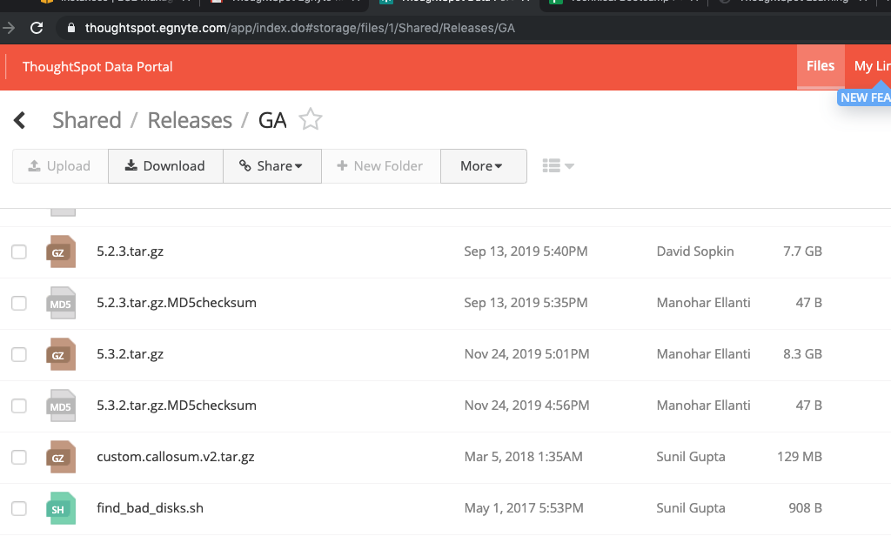
Download binary and copy to cluster
Partners and customers can now download the binary from ThoughtSpot’s secure file sharing site (Egnyte)
Use scp to copy binary to ThoughtSpot server
$scp 5.3.2.tar.gz* admin@dell-node1:~

Slide 10
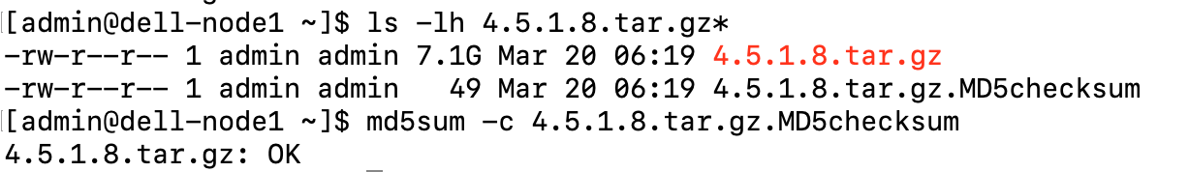
Deploy Cluster
We need to have the binary and md5 uploaded to the system, and ensure the binary is not corrupted. The way to check would be using “md5sum –c <checksum_file>”

Slide 11
Deploy Cluster
We need to have the following information: Cluster Name: Cluster ID: IP Address of the nodes: Alias email for alert (Optional)

Slide 12
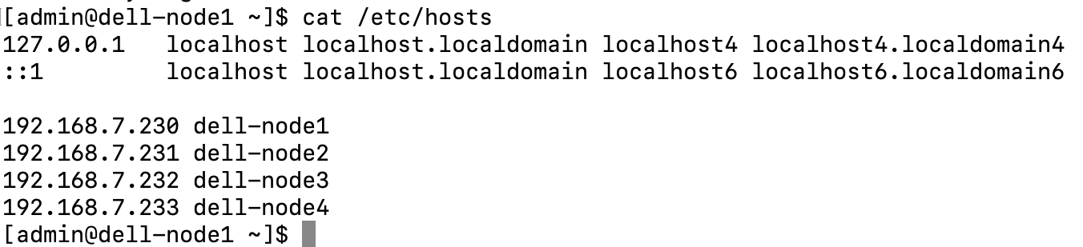
Deploy Cluster
If it’s multi-node cluster (more than 1 node), then we’ll need to ensure the /etc/hosts and /update/etc/hosts have the host information.
Notes:
it.

Slide 13
Deploy Cluster
To create a cluster, the command would be: tscli cluster create <binary_name>

Slide 14
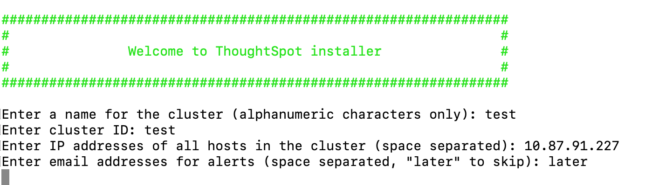
Deploy Cluster
We need to manually input the following information: Cluster Name: Cluster ID: IP Address of the nodes: Alias email for alert (Optional)

Slide 15
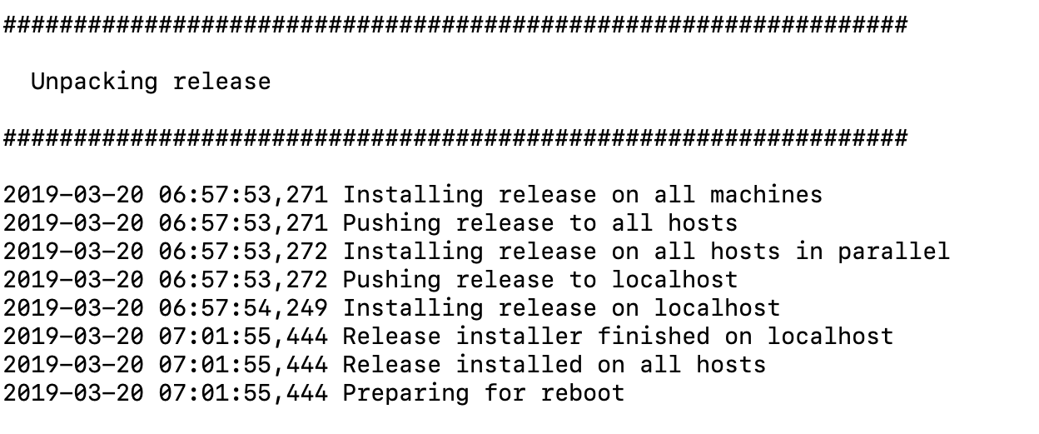
Deploy Cluster
After we input all of the information, it’ll start to install the binary

Slide 16
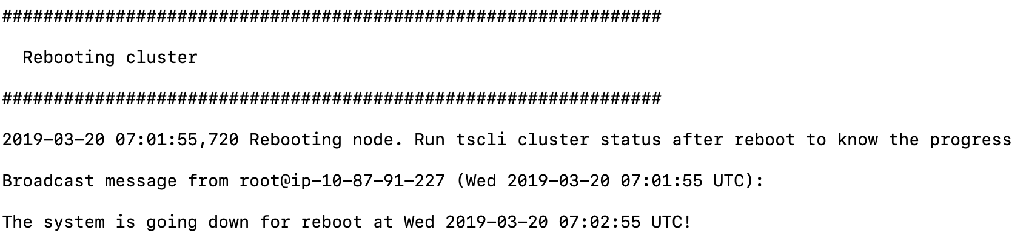
Deploy Cluster
For the first time installation, it’ll require reboot.

Slide 17
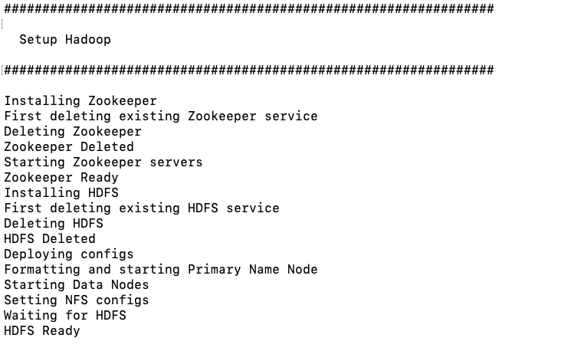
Deploy Cluster
After the reboot, it will begin Hadoop setup

Slide 18
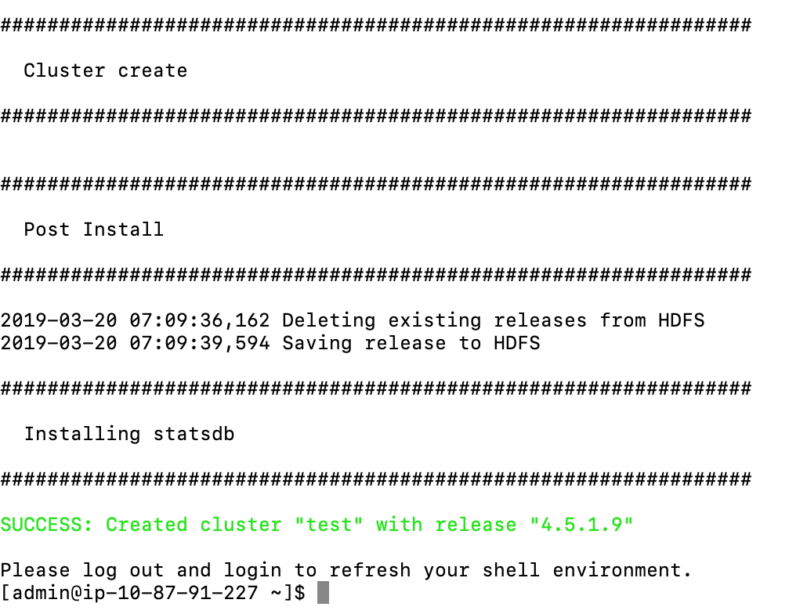
Deploy Cluster
Then it will start to create the cluster services. On a successful deployment, it’ll show at the very end: SUCCESS: Created cluster <cluster_name> with release <release>”. From here we will need to log out to refresh the shell environment.

Slide 19
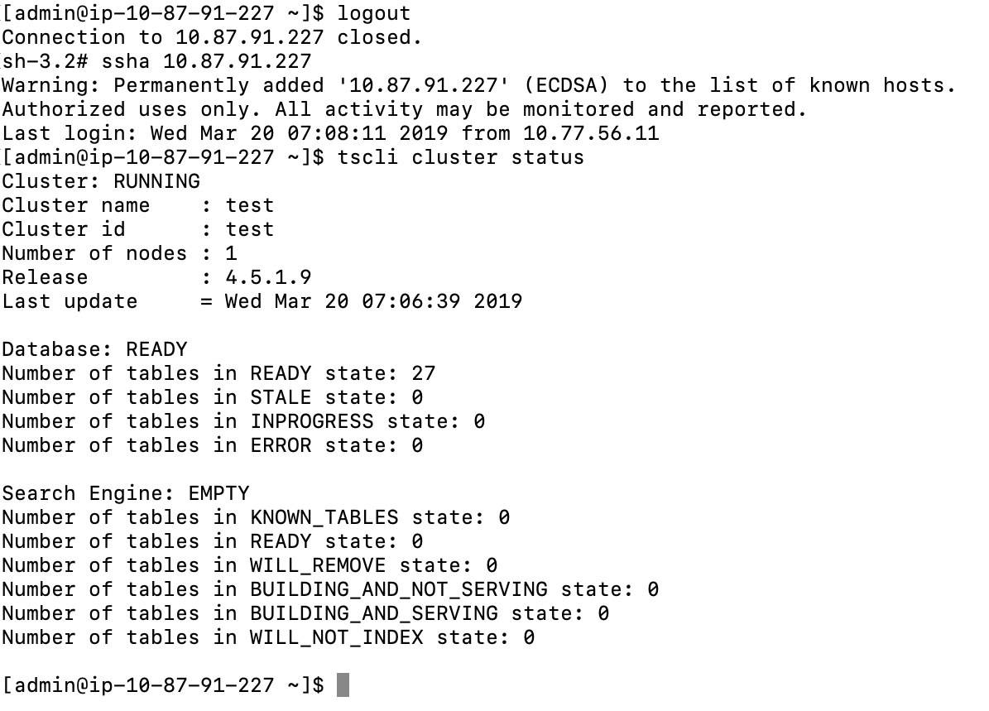
Deploy Cluster
After installation, use tscli cluster status to find out the status of the cluster.
Notes:
Warning just means the RSA key on that a cluster has changed after the reboot, which is not a problem.
Database refers to Falcon. Search engine empty is 0 because it hasn’t indexed yet. If you wait, search engine will show ready because it has finished indexing.

Slide 20
ThoughtSpot Deployment (on Customer Managed OS)

Slide 21
ThoughtSpot on Customer Managed OS
Customers can run ThoughtSpot on an RHEL 7.7 (or later) or Amazon Linux 2 image that they manage.
Prior to this, ThoughtSpot has been shipping ThoughtSpot packaged along with CentOS.
An additional software package (Ansible) is required to enable hosts to be configured for ThoughtSpot

Slide 22
ThoughtSpot Deployment (on Customer Managed OS)
Steps for deployment on Red Hat Enterprise Linux (RHEL):
Prepare nodes for deployment by downloading and running the Ansible Paybook
Run tscli cluster create command
Falcon
Sage
Blink
Tomcat
Orion
Customer Managed
(RHEL or Amazon Linux 2)

Slide 23
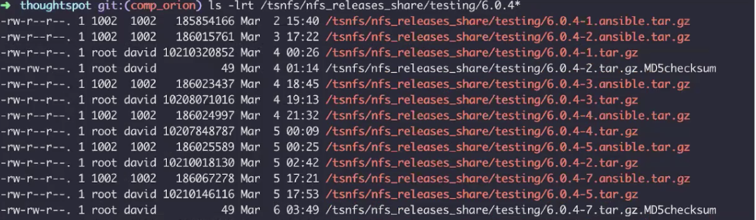
Install ThoughtSpot
RHEL Installation prerequisities can be found here: https://docs.thoughtspot.com/6.0/appliance/rhel/rhel-prerequisites.html
Download Ansible Playbook

Slide 24
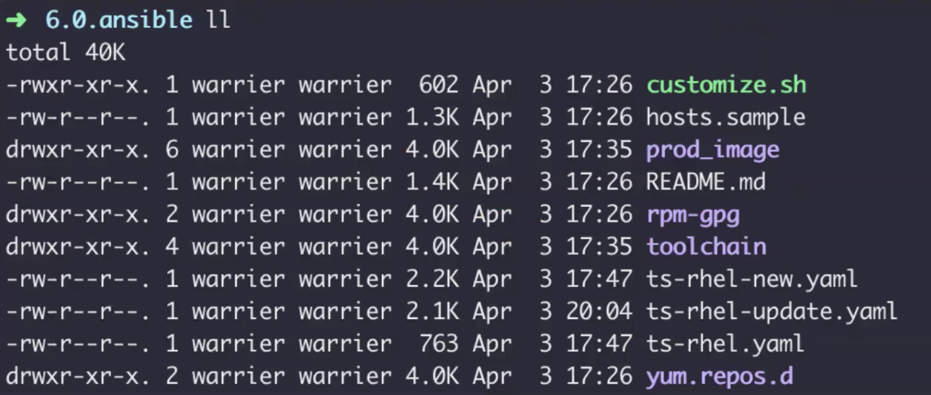
Install ThoughtSpot
Untar Ansible tarball

Slide 25
Install ThoughtSpot
Copy the Ansible inventory file hosts.sample to hosts.yaml, and using a text editor of your choice, update the file to include your host configuration
Run Ansible Playbook
Run tscli cluster create

Slide 26
Introducing TS Cloud

Slide 27





ThoughtSpot Deployment (TS Cloud)
Steps for deployment:
Sign up for TS Cloud
ThoughtSpot’s Cloud Control Plane spins up single node per customer
Connect to data using Embrace for Snowflake or Redshift
Control Plane
Customer A
Customer B
Customer C

Slide 28
Deployment in SaaS Model
All tenants are deployed with a single node
Single tenancy, network-level separation of customers
Customer owns data, while ThoughtSpot hosts environment
Shared responsibility between ThoughtSpot and Customer
ThoughtSpot
Underlying infrastructure (with AWS)
Protection of data in the cloud
Operating System
Application security
Customer
User and Group management
Security of Snowflake or Redshift deployment and data

Slide 29
eLearning Training Videos for Deployment

Slide 30
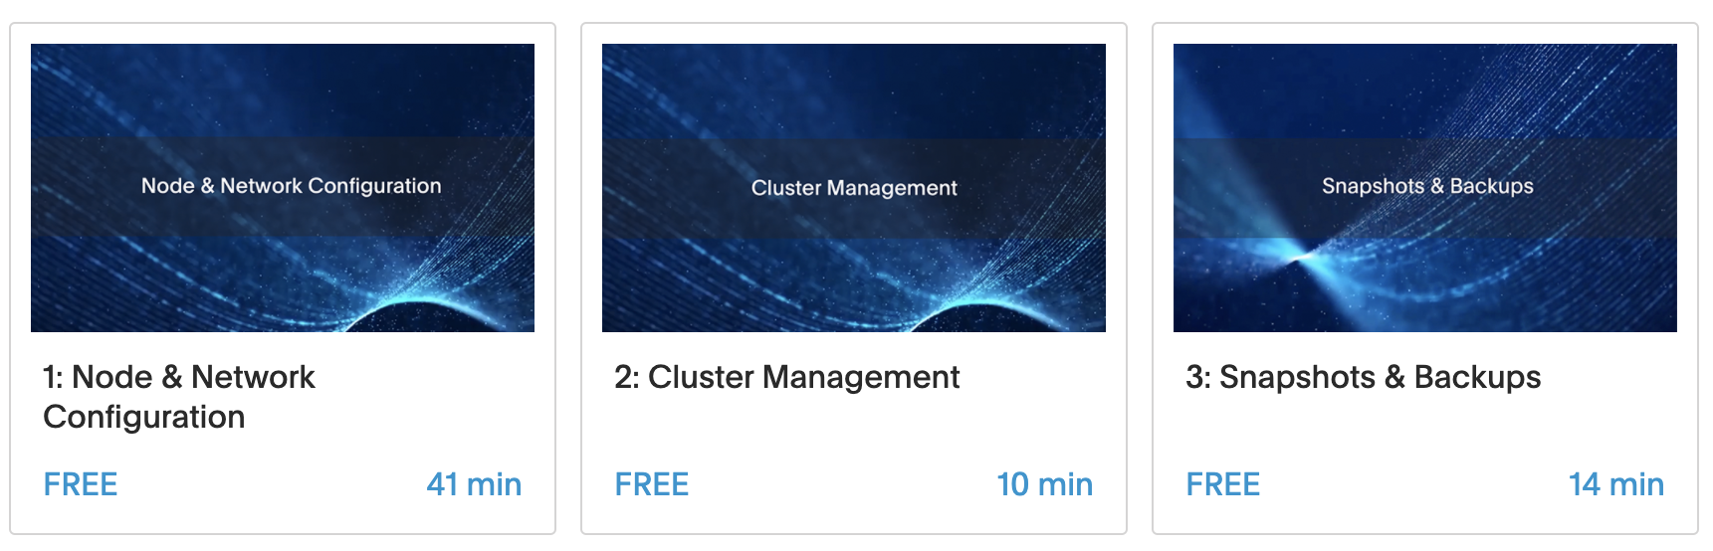
ThoughtSpot U
Free, online, training videos available on ThoughtSpot U
Deployment topics include:
Node & Network Configuration
Cluster Management
Snapshots & Backups
Notes:
Register at training.thoughtspot.com
This course is available under the Architect learning path

Slide 31
Thank you

